Slide 1
Logistic Regression

Slide 2
Logistic Regression
Introduction
Motivation
Pros and cons
When should we use
We’ll be discussing every topic in the aspect of a final project
Final project is to classify the Titanic data

Slide 3
Logistic Regression
Motivation
Like all regression analyses, the logistic regression is a predictive analysis.
Logistic regression is the appropriate regression analysis to conduct when the dependent variable is binary.
Logistic regression is used to describe data and to explain the relationship between one dependent binary variable and one or more independent variables.

Slide 4
Logistic Regression
Pros and cons
Pros
Logistic Regression performs well when the dataset is linearly separable.
Logistic regression is less prone to overfitting but it can overfit in high dimensional datasets.
Logistic regression is easier to implement, interpret and very efficient to train.
Cons
If the number of observations are lesser than the number of features, Logistic Regression should not be used, otherwise it may lead to overfit.
Limitation of Logistic Regression is the assumption of linearity between the dependent variable and the independent variables. In the real world, the data is rarely linearly separable.
Logistic Regression can only be used to predict discrete functions

Slide 5
Logistic Regression
When should we use
When the dataset is linearly separable
When need to predict discrete functions
When need to classify data into two or more categories
Can we use logistic regression if data is not linearly separable?

Slide 6
Logistic Regression
Final project
Introduction to dataset
Goals
Roadmap

Slide 7
Logistic Regression
Reading and manipulating the data
Pandas
Numpy
Reading and manipulating Titanic dataset

Slide 8
Logistic Regression
Pandas
Pandas contains data structures and data analysis tools for the Python programming language.
Pandas is a Python package providing fast, flexible, and expressive data structures designed to make working with “relational” or “labeled” data both easy and intuitive.

Slide 9
Logistic Regression
Numpy
NumPy is the fundamental package for scientific computing with Python.
NumPy is a general-purpose array-processing package.
It provides a high-performance multidimensional array object, and tools for working with these arrays.

Slide 10
Logistic Regression
Preparing data for Machine learning
Data visualization
Matplotlib
Data cleaning
Removing the outliers
Filling/removing missing values
Categorical to numeric conversion

Slide 11
Logistic Regression
Data visualization
Matplotlib
Matplotlib is a Python 2D plotting library which produces publication quality figures in a variety of hard copy formats and interactive environments across platforms.
Matplotlib can be used in Python scripts, the Python and IPython shells, the Jupyter notebook, web application servers, and four graphical user interface toolkits.
Matplotlib tries to make easy things easy and hard things possible. You can generate plots, histograms, power spectra, bar charts, error charts, scatterplots, etc., with just a few lines of code

Slide 12
Logistic Regression
Data cleaning
Removing the outliers
An outlier can be a measurement error or data entry error.
Manually correct the outline if possible.
If you can’t fix it, remove that observation because you know it’s incorrect or it not a part of the population you are studying (i.e., unusual properties or conditions), you can legitimately remove the outlier.

Slide 13
Logistic Regression
Data cleaning
Filling/removing missing values
Missing data is the situation where some values of some cases are missing.
Some fix-up methods are:
Delete the row with missing observations.
Manually fill-in or impute the missing values.

Slide 14
Logistic Regression
Data cleaning
Categorical to numeric conversion
Machine only understands numeric values
We have to convert categorical(non-numeric) values to numeric values such that they do not lose their essence
For example: Sex

Slide 15
Logistic Regression
A quick implementation
Implementing sklearn’s logistic regression model
Are you curious enough to know what is going behind the scenes?
It will help you to tune the performance of your model according to your projects

Slide 16
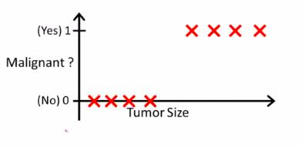
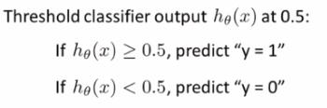
Logistic Regression
Classification in logistic regression
Email: Spam/Not Spam
Tumor: Malignant/Not Malignant

Slide 17
Logistic Regression
Logistic function
Sigmoid
Decision boundary

Slide 18
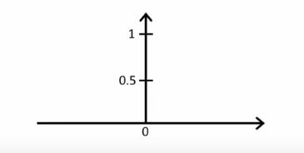

Logistic Regression
Sigmoid
A sigmoid function is a mathematical function having a characteristic "S"-shaped curve or sigmoid curve.
Sigmoid function and logistic function are synonym
logistic regression transforms its output using the logistic sigmoid function to return a probability value which can then be mapped to two or more discrete classes.

Slide 19
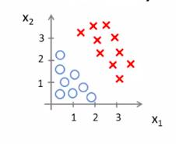

Logistic Regression
Decision boundary
It is a hyperparameter
For example
y = 1 if P(x) > 0.5
y = 0 if P(x) < 0.5

Slide 20
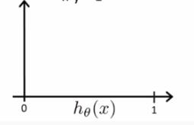
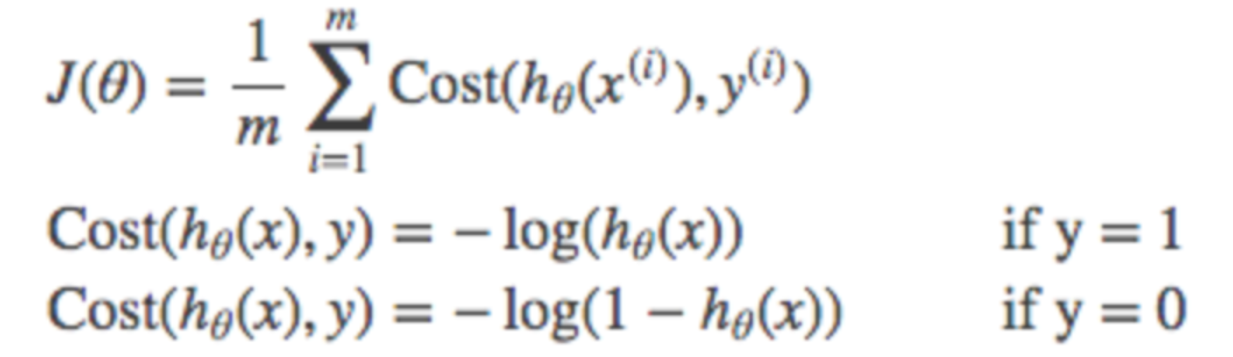
Logistic Regression
Cost functions
What is cost function?
The cost function we use in logistic regression is called Cross-Entropy, also known as Log Loss.
Cross-entropy loss is split into two separate cost functions
When dealing with a binary classification problem: for y=0 and y=1

Slide 21
Logistic Regression
Gradient descent
Global minima vs local minima
Achieving global minima
Implementing in python

Slide 22
Logistic Regression
Global minima vs local minima
We denote maxima or minima as either global or local. Simply writing maxima or minima is confusing and are taken to be the global ones by convention.
A maximum or minimum is said to be local if it is the largest or smallest value of the function, respectively, within a given range.
However, a maximum or minimum is said to be global if it is the largest or smallest value of the function, respectively, on the entire domain of a function.

Slide 23
Logistic Regression
Achieving global minima
Gradient Descent is the most common optimization algorithm in machine learning and deep learning.
It is a first-order optimization algorithm.
This means it only takes into account the first derivative when performing the updates on the parameters.
On each iteration, we update the parameters in the opposite direction of the gradient of the objective function J(w) w.r.t the parameters where the gradient gives the direction of the steepest ascent.
The size of the step we take on each iteration to reach the local minimum is determined by the learning rate α.

Slide 24
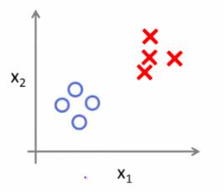
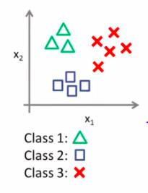
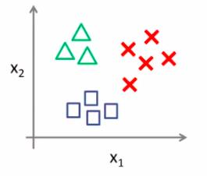
Logistic Regression
Classification
Binary classification
Implementing in python
Multi-class classification using binary classification
1 vs rest rule
Implementing in python

Slide 25
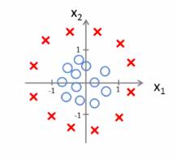

Logistic Regression
Important notes
SVM vs logistic regression
Logistic regression in higher dimension space(non- linear)

Slide 26
Logistic Regression
Concluding
Further instructions to implement logistic regression on other data sets
Answers to frequently asked questions

Slide 27
Logistic Regression
Further installations to implement logistic regression on other data sets
Get the labeled dataset
Remove outliers
Fill/remove missing values
Normalize the data
Train the model
Test the model
validation

Slide 28
Logistic Regression
Answers to frequently asked questions
Is Logistic regression a supervised machine learning algorithm?
Is Logistic regression mainly used for Regression?
Is it possible to apply a logistic regression algorithm on a 3-class Classification problem?
Any other question?

